Slide 1
Advancing the Equity Agenda
Equity-Minded Goalsetting
Board of Higher Education Meeting – May 5, 2020

Slide 2

Context
Equity-Minded Goalsetting
DHE has been solicited to apply for
multiple Lumina Foundation grants,
totaling to $1.25m, to support the
Equity Agenda
APPLICATION PLANNED | APPLICATIONS SUBMITTED
TIE (Talent, Innovation, Equity) Grant | Equity Institutions Grant | Data Dashboard Challenge Grant
Project intended to support systemwide work focused on racial equity and dismantling systemic barriers faced by students of color Requires setting of clear goals for equity and attainment | Project intended to complement systemwide TIE work by elevating and linking the work of six Equity Institutions: CC: Bunker Hill, Greenfield, Holyoke SU: Bridgewater, MassArt UMass Boston | Project intended to support monitoring and reassessing progress toward TIE Grant goals at state and regional/local levels, and building forecast scenarios to better inform ongoing goalsetting, policy & budgetary decisions, policy implementations

Slide 3
Context
Equity-Minded Goalsetting
DHE has been solicited to apply for
multiple Lumina Foundation grants,
totaling to $1.25m, to support the
Equity Agenda
APPLICATION PLANNED | APPLICATIONS SUBMITTED
TIE (Talent, Innovation, Equity) Grant | Equity Institutions Grant | Data Dashboard Challenge Grant
Project intended to support systemwide work focused on racial equity and dismantling systemic barriers faced by students of color Requires setting of clear goals for equity and attainment | Project intended to complement systemwide TIE work by elevating and linking the work of six Equity Institutions: CC: Bunker Hill, Greenfield, Holyoke SU: Bridgewater, MassArt UMass Boston | Project intended to support monitoring and reassessing progress toward TIE Grant goals at state and regional/local levels, and building forecast scenarios to better inform ongoing goalsetting, policy & budgetary decisions, policy implementations

Slide 4
External Factors that May Affect Progress Toward Equity-Minded Goals
Equity-Minded Goalsetting

Slide 5
Key Potential Factors
External Factors that May Affect Progress Toward Goals
Demographic Changes
Impact of K–12 Trends
Demand for
Higher Education
Funding for
Higher Education
College Closures & Mergers
Economy

Slide 6
Key Potential Factors
External Factors that May Affect Progress Toward Goals
Demographic Changes
Impact of K–12 Trends
Demand for
Higher Education
Funding for
Higher Education
College Closures & Mergers
Economy
  fewer students in
  traditional-age pipeline
  growth in populations
  that have traditionally
  been underserved by
  higher education
  retirements of working-age residents with
  postsecondary credentials
  regional variation in population and demographic trends, especially in
  urban vs. rural regions

Slide 7
Key Potential Factors
External Factors that May Affect Progress Toward Goals
Demographic Changes
Impact of K–12 Trends
Demand for
Higher Education
Funding for
Higher Education
College Closures & Mergers
Economy
  continued declines in high school dropout rates
  interest in vocational education leading to direct employment after HS

Slide 8
Key Potential Factors
External Factors that May Affect Progress Toward Goals
Demographic Changes
Impact of K–12 Trends
Demand for
Higher Education
Funding for
Higher Education
College Closures & Mergers
Economy
  shifting attitudes toward value of higher education
  changes in employer requirements for postsecondary credentials/types

Slide 9
Key Potential Factors
External Factors that May Affect Progress Toward Goals
Demographic Changes
Impact of K–12 Trends
Demand for
Higher Education
Funding for
Higher Education
College Closures & Mergers
Economy
  changes in federal & state funding for financial aid &
  higher education

Slide 10
Key Potential Factors
External Factors that May Affect Progress Toward Goals
Demographic Changes
Impact of K–12 Trends
Demand for
Higher Education
Funding for
Higher Education
College Closures & Mergers
Economy
  student progress toward completion may be
  disrupted by closures
  public institutions may
  attract students from
  closed institutions

Slide 11
Key Potential Factors
External Factors that May Affect Progress Toward Goals
Demographic Changes
Impact of K–12 Trends
Demand for
Higher Education
Funding for
Higher Education
College Closures & Mergers
Economy
  changes in in-migration of educated workers, e.g., driven by employment opportunities
  changes in out-migration of educated workers, e.g., driven by cost of living
  higher unemployment rates are correlated with enrollment increases, especially at community colleges (but not necessarily increases in completion rates)

Slide 12
Key Potential Factors
External Factors that May Affect Progress Toward Goals
Demographic Changes
Impact of K–12 Trends
Demand for
Higher Education
Funding for
Higher Education
College Closures & Mergers
Economy
  May produce
  unprecedented shifts in
  many aforementioned factors
  higher unemployment rates
  decreases in federal and state funding
  college closures and mergers
  May introduce new factors
  emotional trauma and health concerns
  affecting student progress, whether they are retained or not
  students questioning cost/value of remote learning vs. traditional
  inequitable access to—or design of—remote learning
  impact on international students
  & enrollment
COVID-19

Slide 13
Impact on Goalsetting
External Factors that May Affect Progress Toward Goals
Baselines and forecasts for today’s goalsetting are largely based on historical trends
New, evolving reality and analytic advancements may require revisiting
these goals in the future
COVID-19 especially may negatively affect projections and goals, but should also
serve as a strong imperative—and perhaps
an opportunity—to address inequities
in higher education

Slide 14
State Population Goals
Equity-Minded Goalsetting

Slide 15
1. High-Quality Certificate & Higher
State Population Goals
% of Massachusetts residents ages 25–64
who hold a high-quality certificate or higher
Trend & baseline source: Lumina Foundation,
Stronger Nation annual reports; most recently published
in February 2020
  Lumina data sources:
    Associate degree & higher: U.S. Census Bureau
    High-quality certificate: Lumina/Georgetown Center for Education and Workforce analysis of U.S. Census Bureau and IPEDS data
      Note: “High-quality” means earnings of graduates are 20% higher than earnings of adults with only a HS diploma
TIE Grant Requirement: Set a goal on this metric to achieve by 2030
METRIC

Slide 16
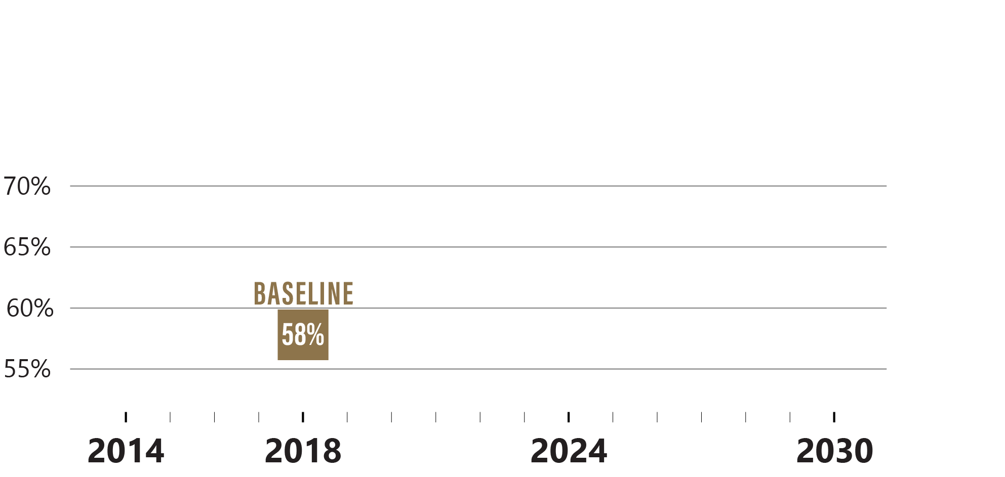
1. High-Quality Certificate & Higher
State Population Goals
% of Massachusetts residents ages 25–64
who hold a high-quality certificate or higher

Slide 17
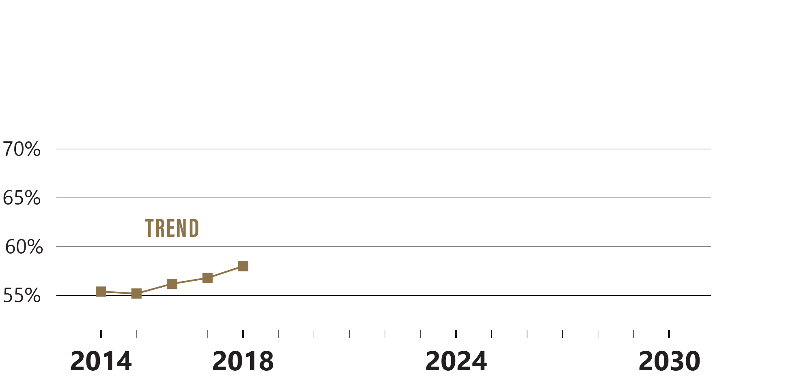
1. High-Quality Certificate & Higher
State Population Goals
% of Massachusetts residents ages 25–64
who hold a high-quality certificate or higher
Only five years of trend data are available, as high-quality certificates were not
tracked by Lumina prior to 2014.

Slide 18
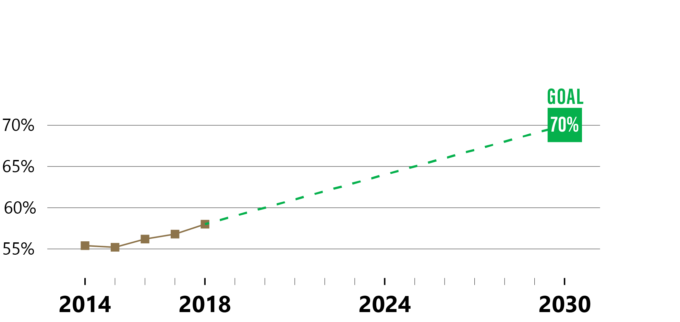
1. High-Quality Certificate & Higher
State Population Goals
% of Massachusetts residents ages 25–64
who hold a high-quality certificate or higher
As mentioned, BHE reserves the right to increase this goal if future modeling
suggest more robust increases are likely.

Slide 19
2. Equity in Associate Degree & Higher
State Population Goals
% of Mass. residents ages 25–64 who hold an
associate degree or higher—by race/ethnicity
Trend & baseline source: Lumina Foundation,
Stronger Nation annual reports; most recently published
in February 2020
  Lumina data sources:
    Associate degree & higher: U.S. Census Bureau
    Note: High-quality certificate data is excluded because it does not allow for disaggregation by race/ethnicity
Forecast source: Mass. Department of Higher Education
TIE Grant Requirement: Set a goal to increase these rates for African American & Latinx residents by 5 percentage points by 2024 (the end of the grant period)
METRIC

Slide 20
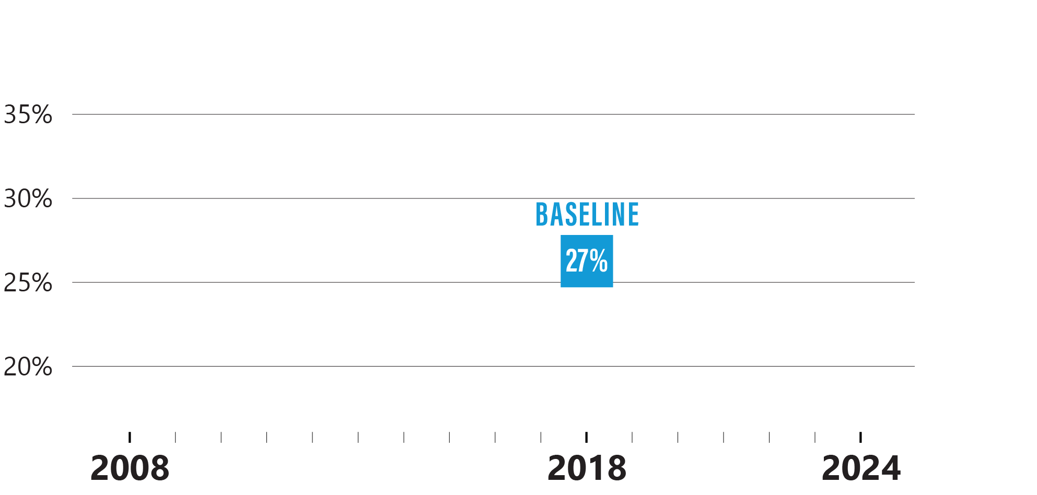
2. Equity in Associate Degree & Higher
State Population Goals
% of Mass. residents ages 25–64 who hold an associate degree or higher—Latinx

Slide 21
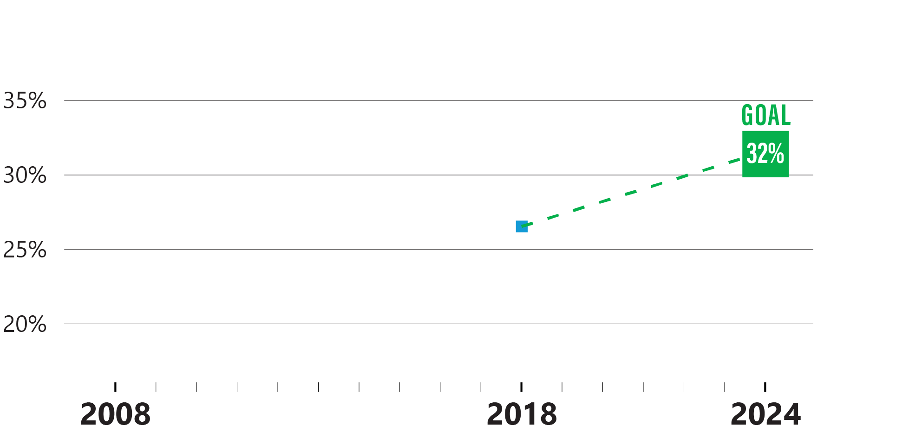
2. Equity in Associate Degree & Higher
State Population Goals
% of Mass. residents ages 25–64 who hold an associate degree or higher—Latinx
Goal meets Lumina requirement to increase rate by 5 percentage points by 2024.

Slide 22
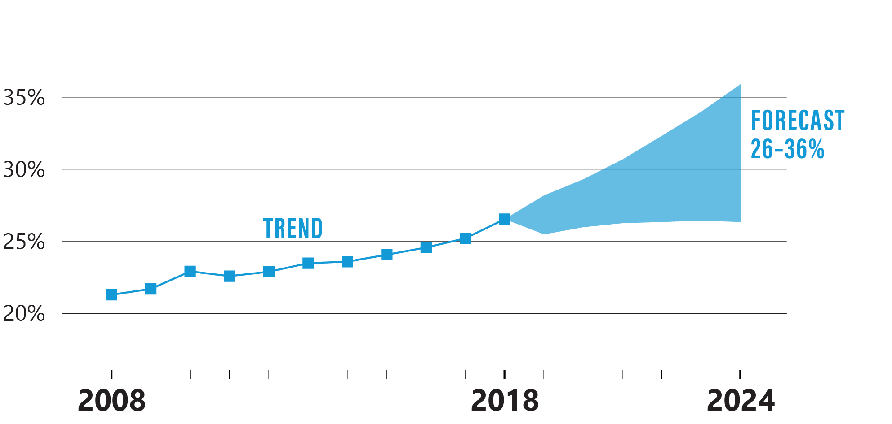
2. Equity in Associate Degree & Higher
State Population Goals
% of Mass. residents ages 25–64 who hold an associate degree or higher—Latinx
Upward trend has been rather steady for 10 years; forecast shown with
95% prediction interval.

Slide 23
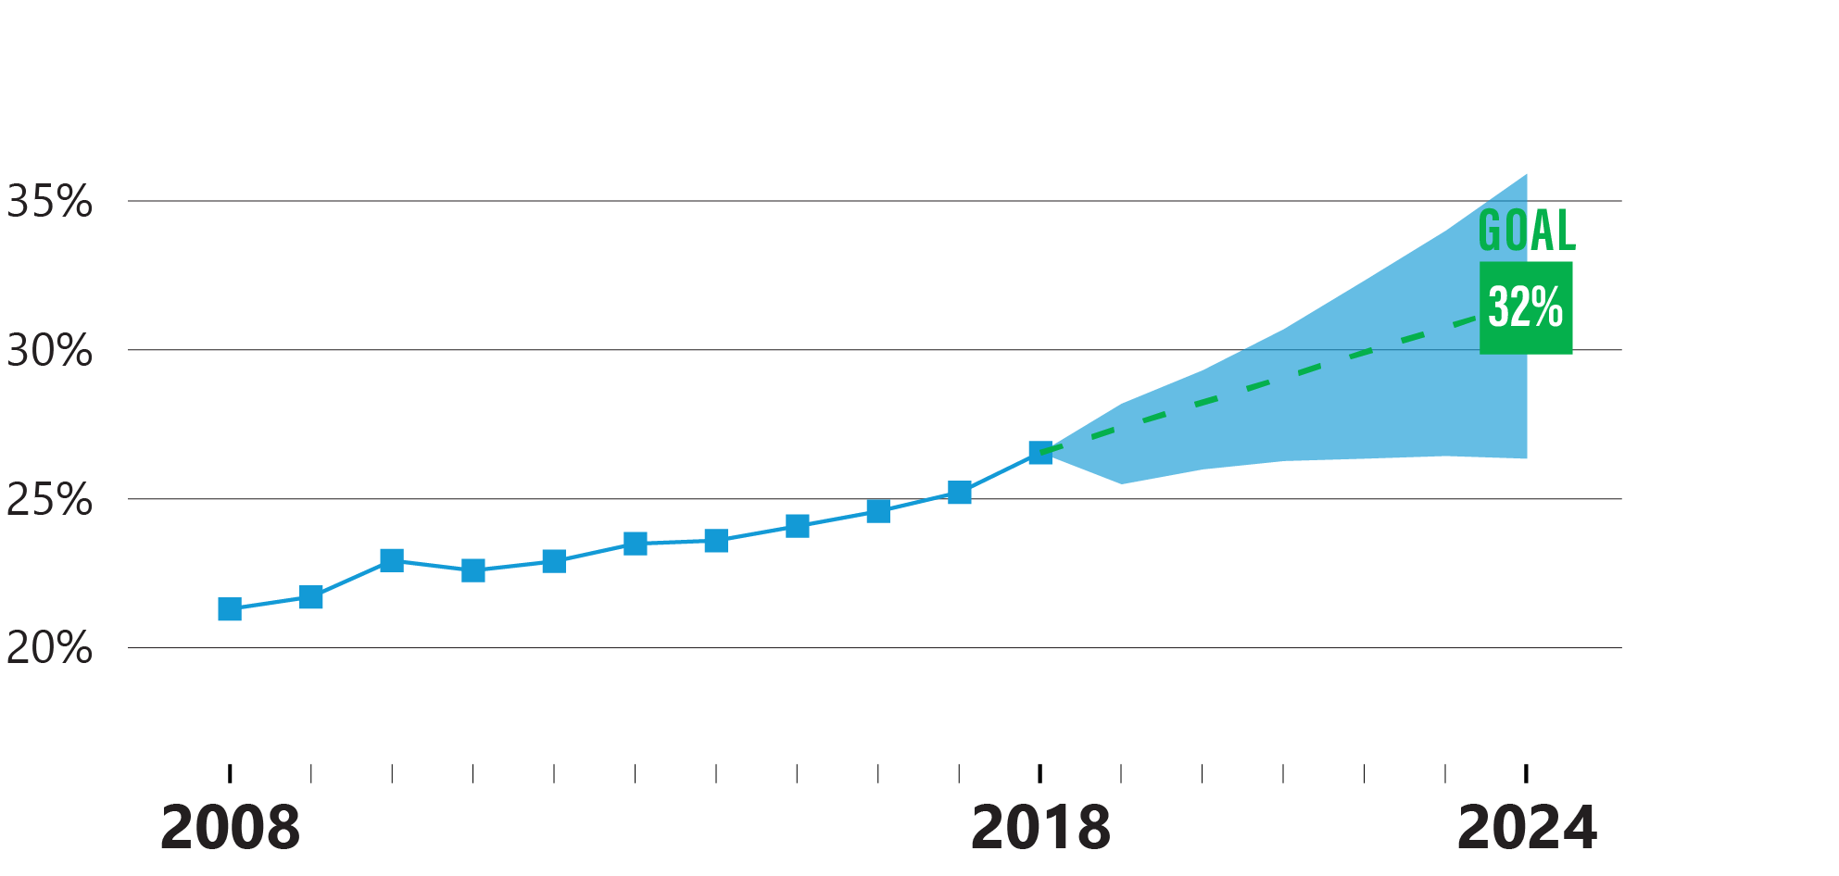
2. Equity in Associate Degree & Higher
State Population Goals
% of Mass. residents ages 25–64 who hold an associate degree or higher—Latinx
Lumina’s prescribed goal falls within the 95% prediction interval.

Slide 24
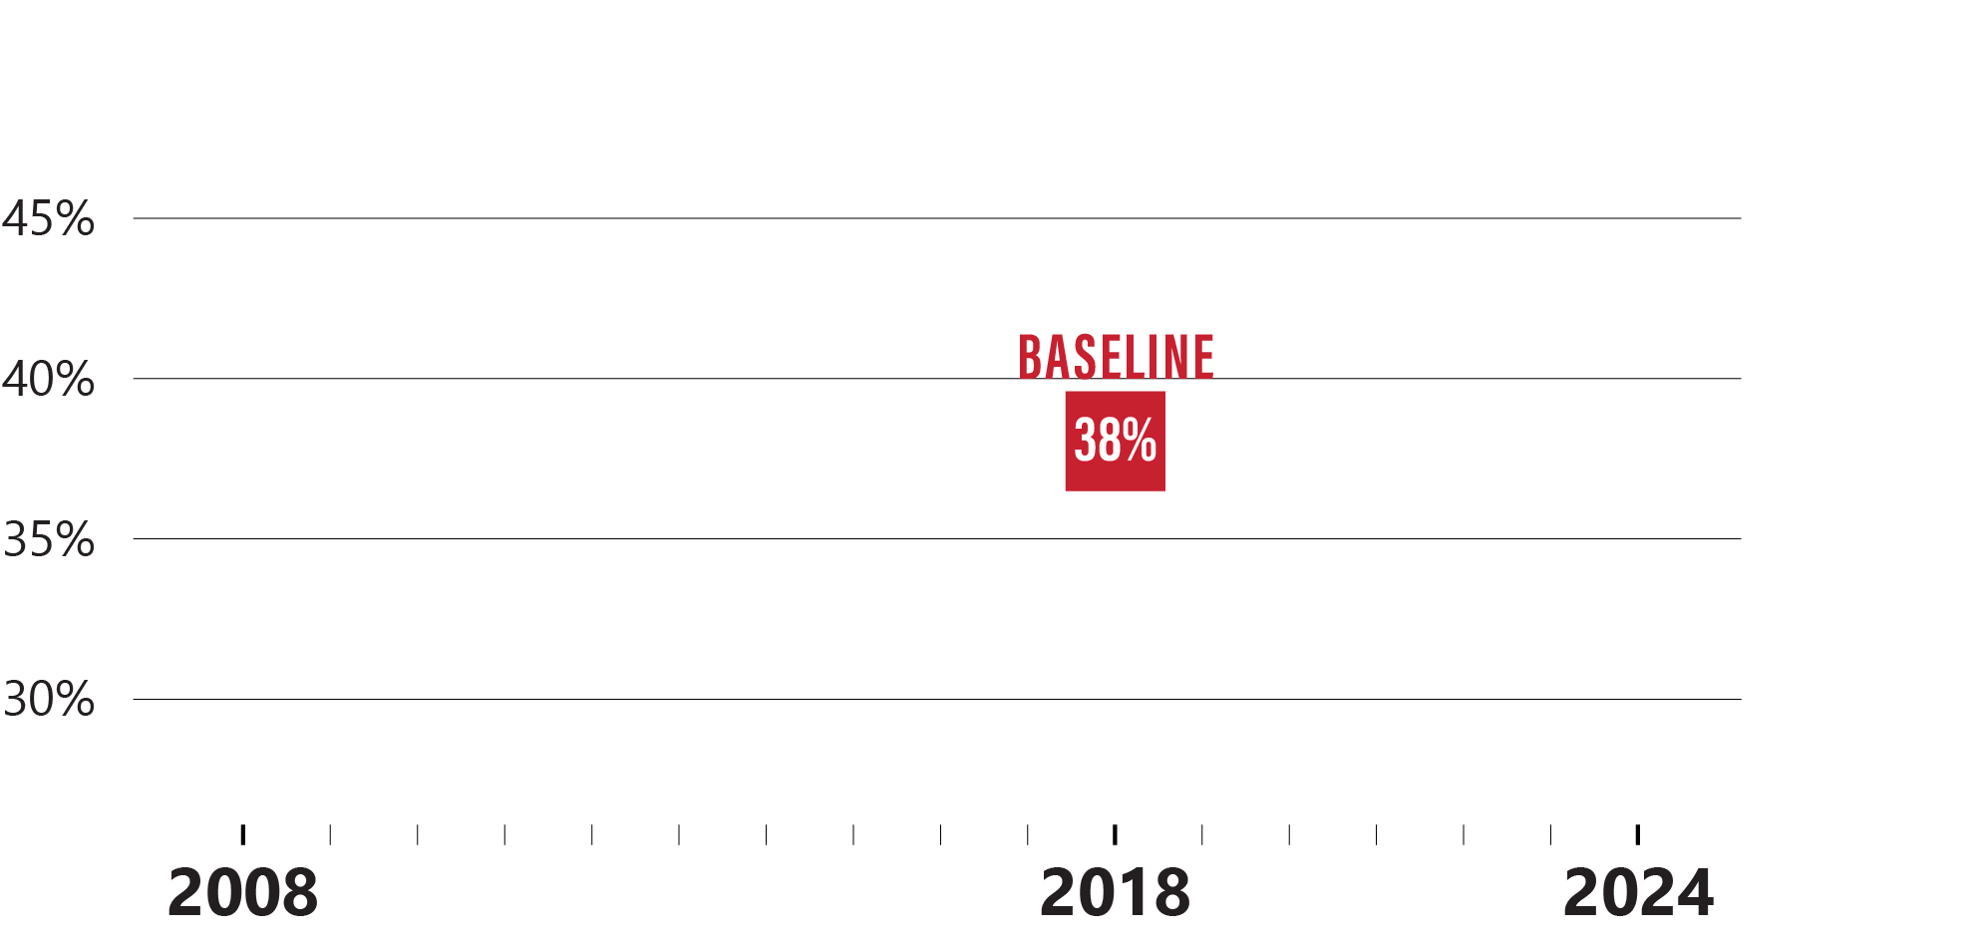
2. Equity in Associate Degree & Higher
State Population Goals
% of Mass. residents ages 25–64 who hold an associate degree or higher—African American

Slide 25
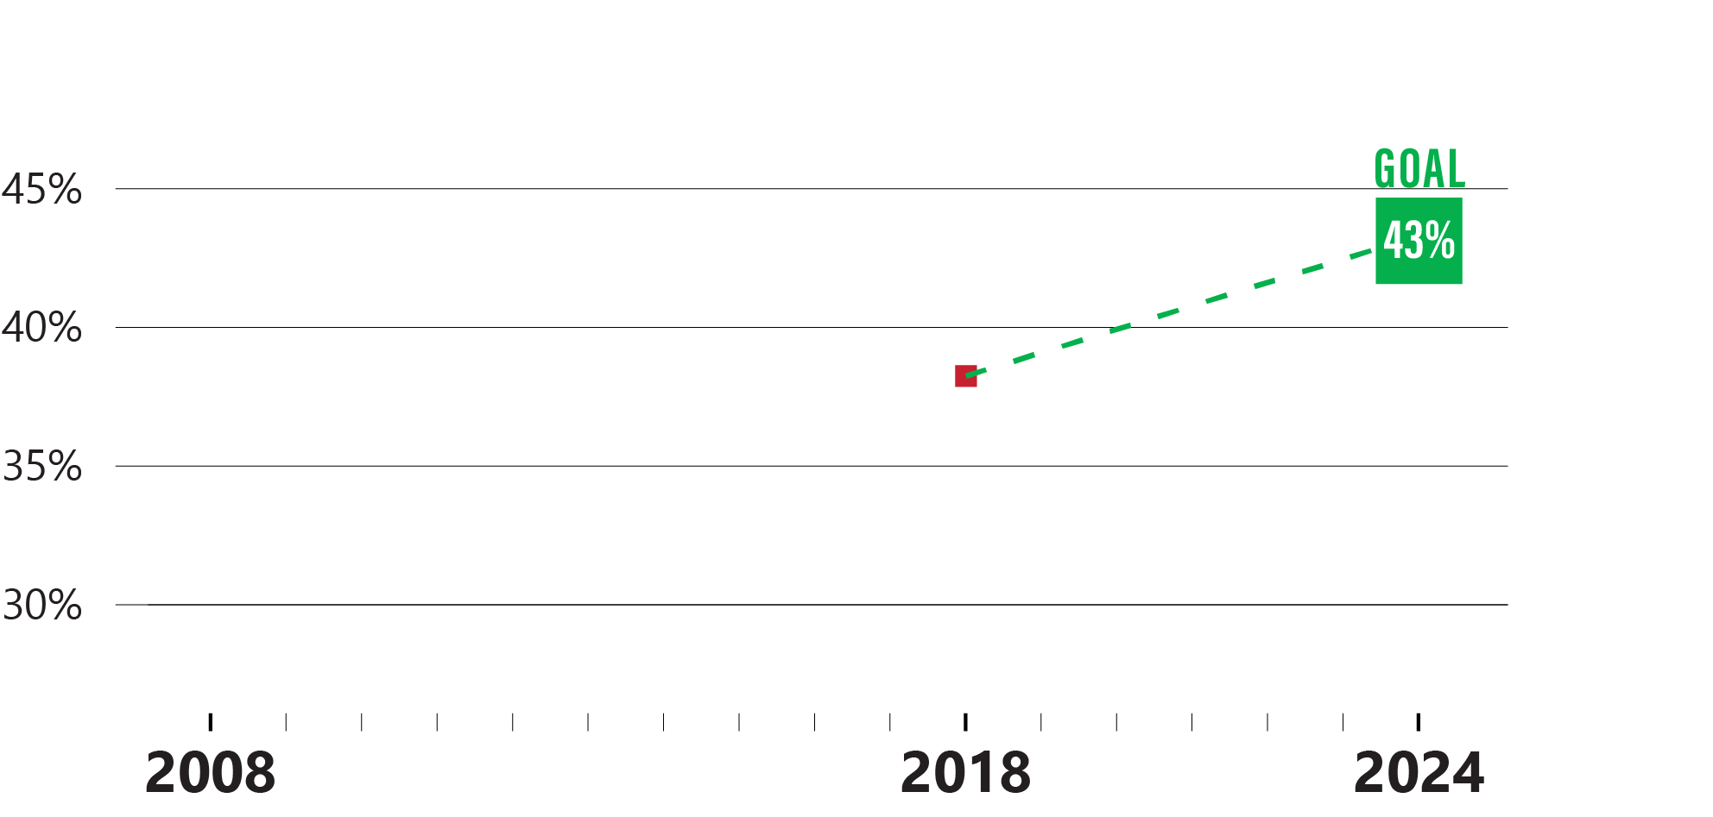
2. Equity in Associate Degree & Higher
State Population Goals
% of Mass. residents ages 25–64 who hold an associate degree or higher—African American
Goal meets Lumina requirement to increase rate by 5 percentage points by 2024.

Slide 26
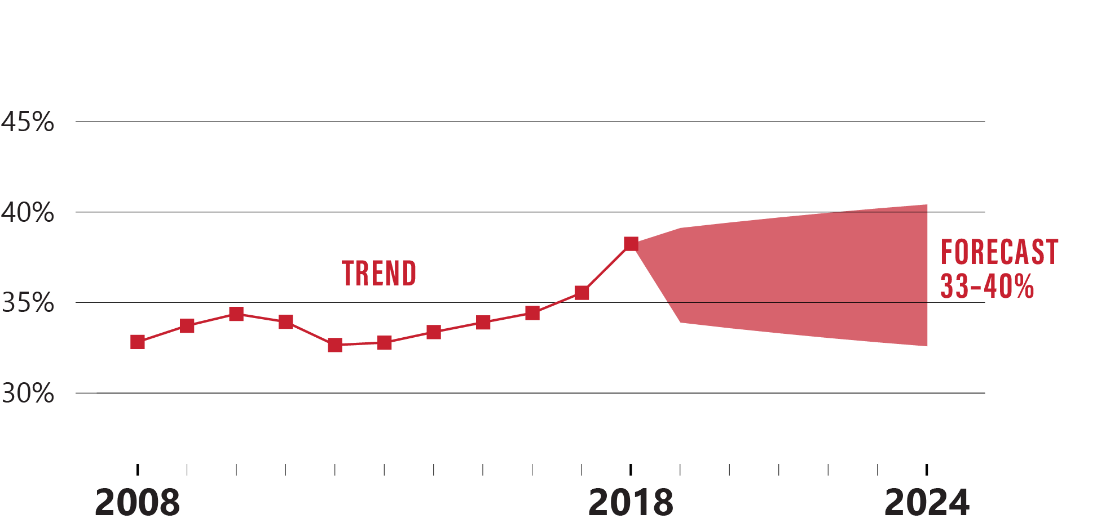
2. Equity in Associate Degree & Higher
State Population Goals
% of Mass. residents ages 25–64 who hold an associate degree or higher—African American
Volatile trend means the prediction interval is wide, even in the near-term years.

Slide 27
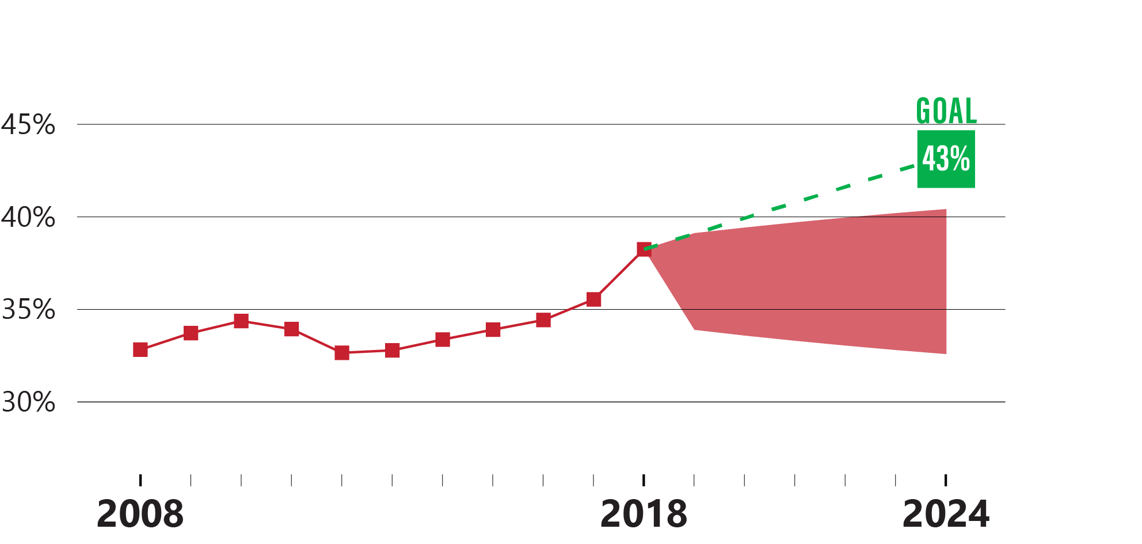
2. Equity in Associate Degree & Higher
State Population Goals
% of Mass. residents ages 25–64 who hold an associate degree or higher—African American
Lumina’s prescribed goal will require outpacing this forecast.

Slide 28
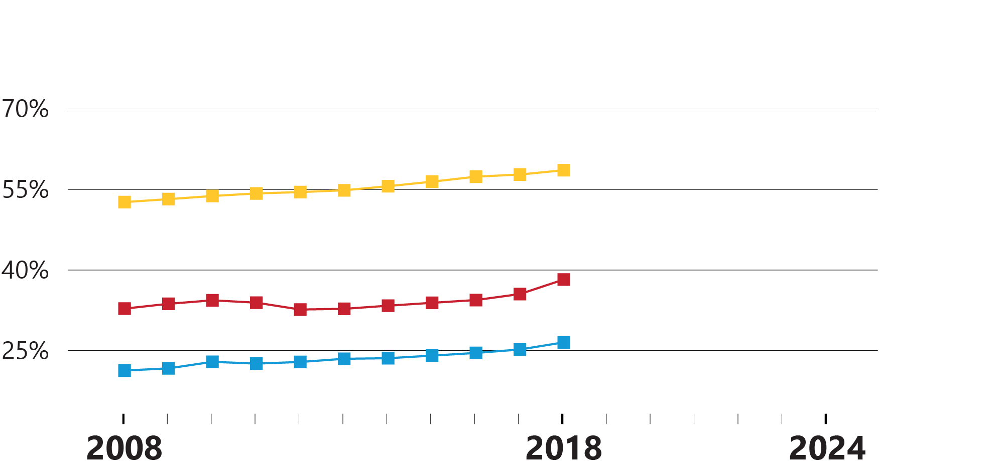
2. Equity in Associate Degree & Higher
State Population Goals
Context: Past trend shows large, persistent disparities over time, despite increased rates for each subgroup

Slide 29
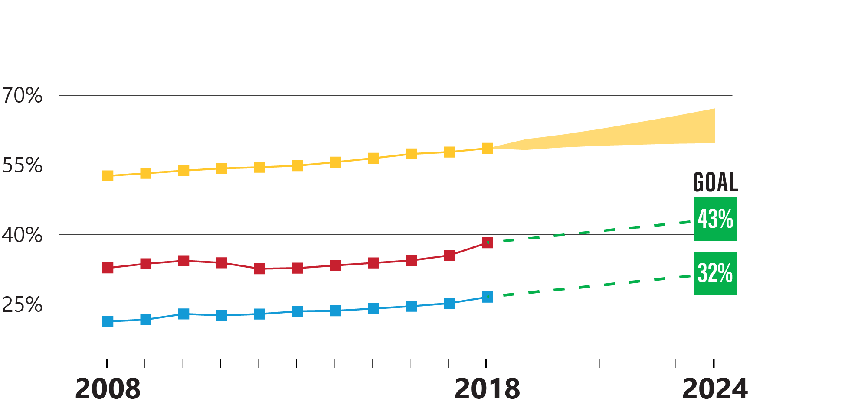
2. Equity in Associate Degree & Higher
State Population Goals
Context: Achieving goal may mean progress in reducing disparities, along with increased rates for each subgroup

Slide 30
Massachusetts Public
Higher Education Goals
Equity-Minded Goalsetting

Slide 31
3. Equity in Public Higher Ed Completion
Massachusetts Public Higher Education Goals
Significance of
Public Higher Ed Completion Metric
  Area in which BHE policy decisions have the most direct impact
  Majority of students of color in postsecondary education in Massachusetts attend public institutions
% of Massachusetts postsecondary students enrolled in public higher ed (FY2018):
62%
of African American undergraduates
61%
of Latinx undergraduates
54%
of White undergraduates
Source: U.S. Department of Education (IPEDS)

Slide 32
3. Equity in Public Higher Ed Completion
Massachusetts Public Higher Education Goals
% of students completing credential
after first enrolling in Mass. public
higher education—by race/ethnicity
Trend & baseline source: Mass. Department of Higher Education (HEIRS), National Student Clearinghouse
  Cohort: All students who enter Mass. public higher education as first-time undergraduates or new transfer students, whether full- or part-time
  Desired Outcome: Students graduate with a certificate or degree within
  six years from any institution in U.S., public or private
  Note: Agnostic of which segment/institution the student initially attended—
  one metric for whole system
Forecast source: Mass. Department of Higher Education
TIE Grant Requirement: Set an aspirational goal to achieve by 2024
METRIC

Slide 33
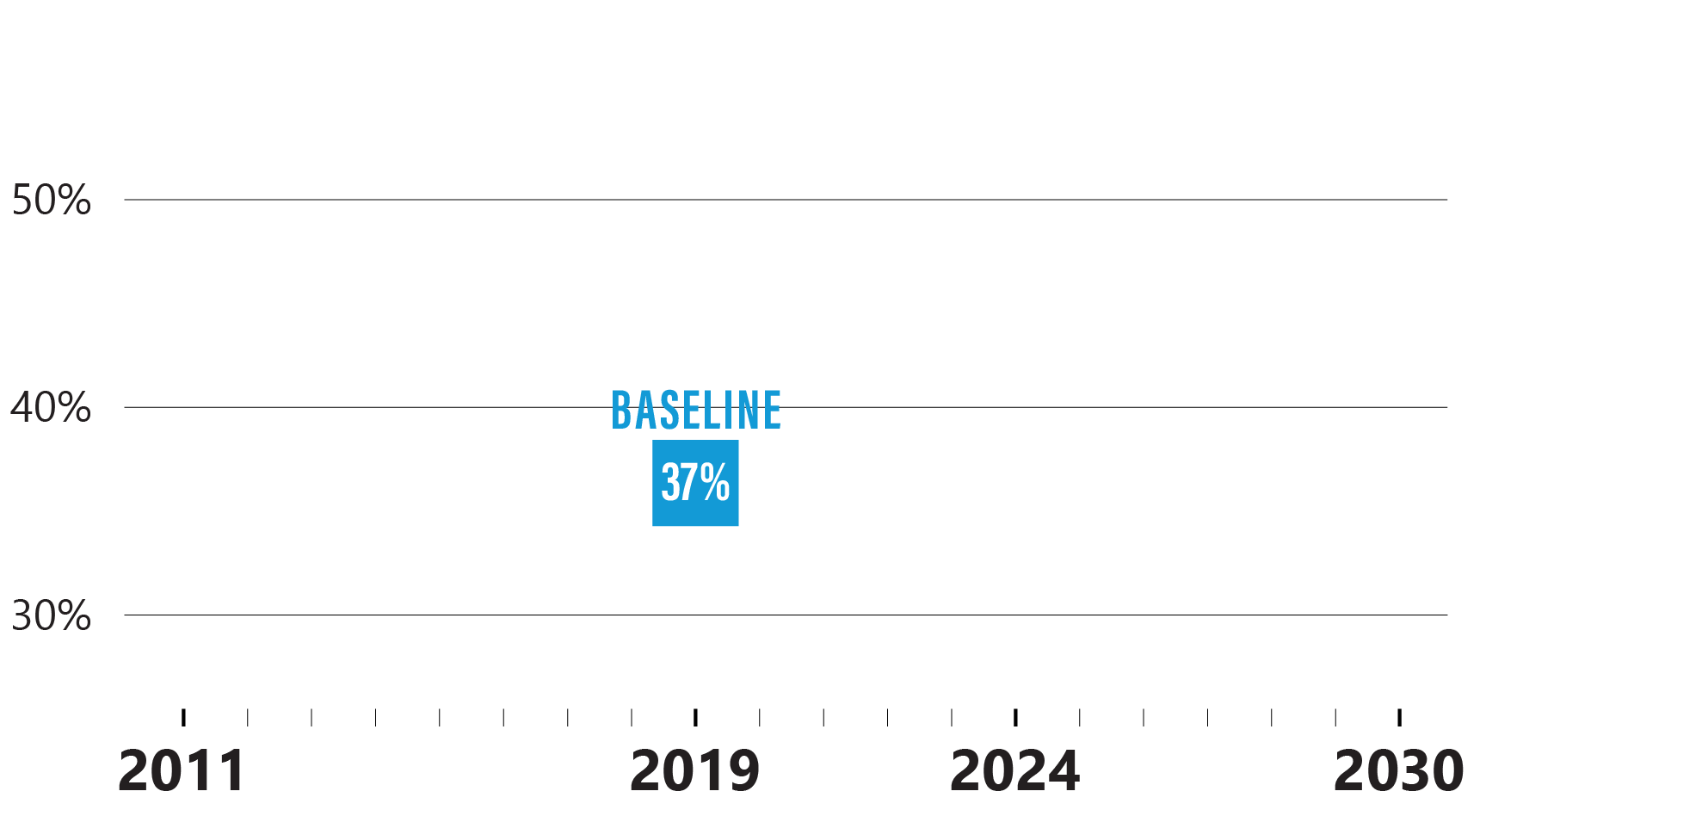
3. Equity in Public Higher Ed Completion
Massachusetts Public Higher Education Goals
% of students completing credential after first enrolling in Mass. public higher education—Latinx
(Entered 2013, earned credential by 2019)

Slide 34
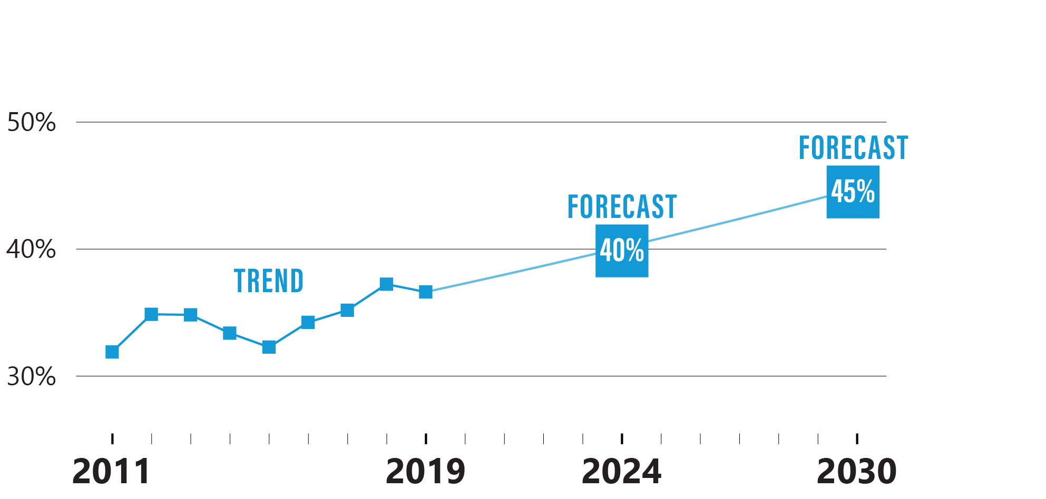
3. Equity in Public Higher Ed Completion
Massachusetts Public Higher Education Goals
% of students completing credential after first enrolling in Mass. public higher education—Latinx
(Entered 2005, earned credential by 2011)
(Entered 2013, earned credential by 2019)
(Entered 2018, earn credential by 2024)
(Enter 2024, earn
credential by 2030)
Trend is volatile, with a dip in the rate for the cohorts who enrolled during the
Great Recession. AAGR for 2011–2019 (1.8%) applied to future cohorts.

Slide 35
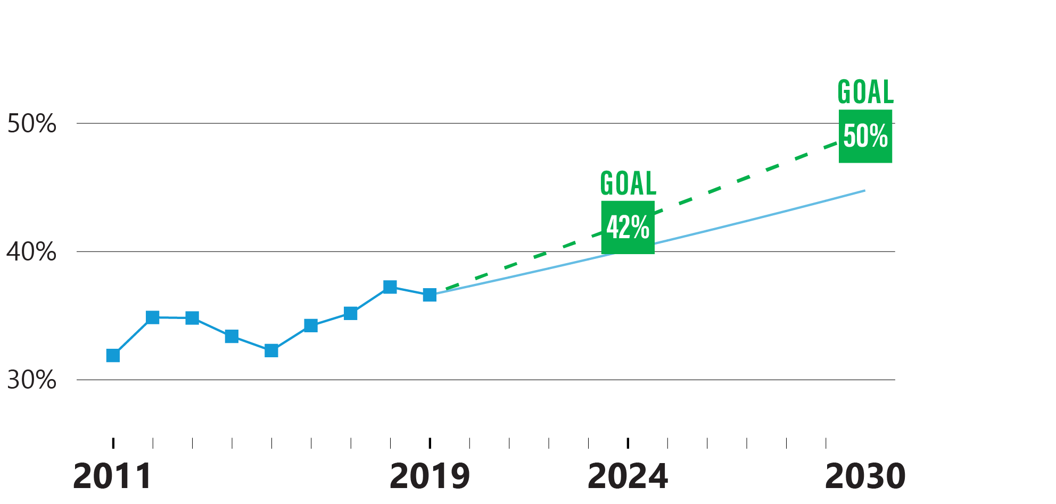
3. Equity in Public Higher Ed Completion
Massachusetts Public Higher Education Goals
% of students completing credential after first enrolling in Mass. public higher education—Latinx
(Entered 2005, earned credential by 2011)
(Entered 2013, earned credential by 2019)
(Entered 2018, earn credential by 2024)
(Enter 2024, earn
credential by 2030)
Goal represents aspiration to exceed current pace by 5% in 2024 (40 * 1.05 = 42)
and 10% in 2030 (45 * 1.1 = 50).

Slide 36
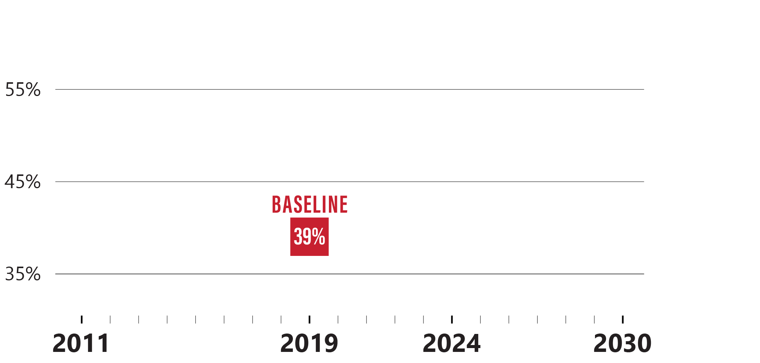
3. Equity in Public Higher Ed Completion
Massachusetts Public Higher Education Goals
% of students completing credential after first enrolling in Mass. public higher education—African American
(Entered 2013, earned credential by 2019)

Slide 37
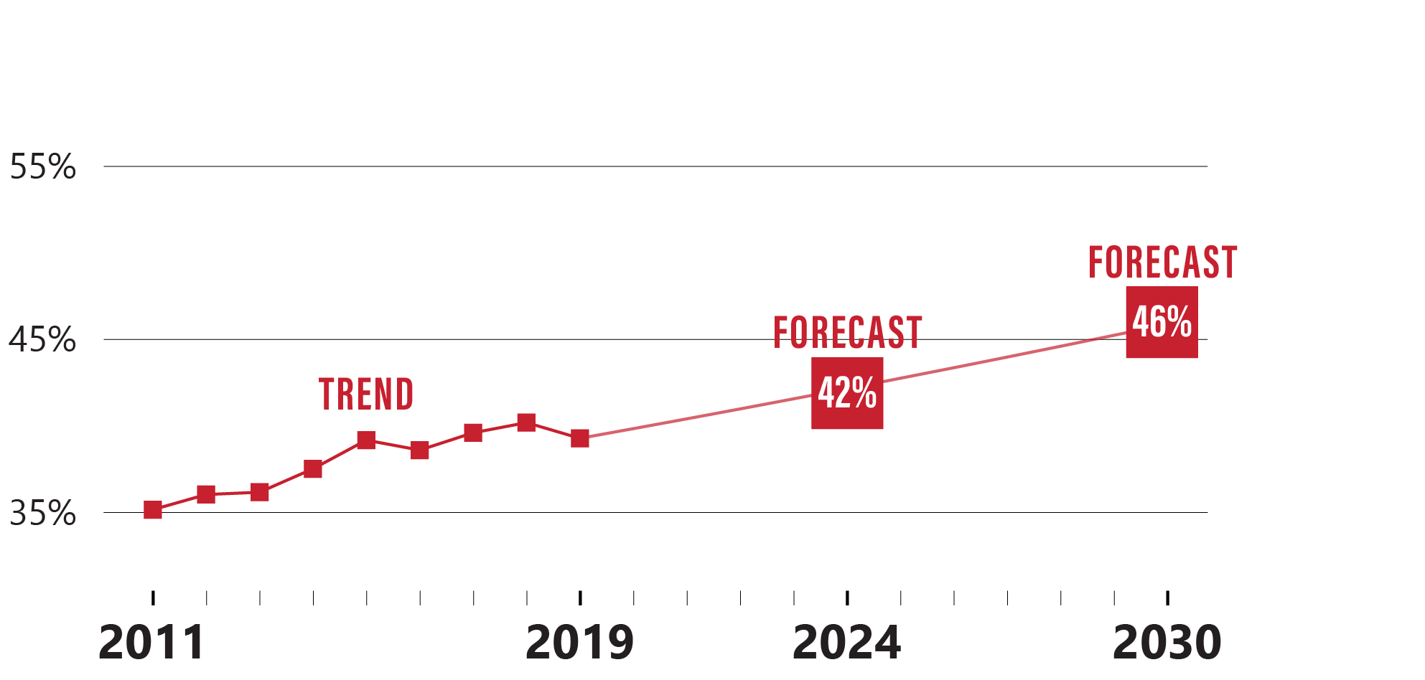
3. Equity in Public Higher Ed Completion
Massachusetts Public Higher Education Goals
% of students completing credential after first enrolling in Mass. public higher education—African American
(Entered 2005, earned credential by 2011)
(Entered 2013, earned credential by 2019)
(Entered 2018, earn credential by 2024)
(Enter 2024, earn
credential by 2030)
Trend is volatile, but mostly climbing, even during Great Recession. AAGR for
2011–2019 (1.4%) applied to future cohorts.

Slide 38
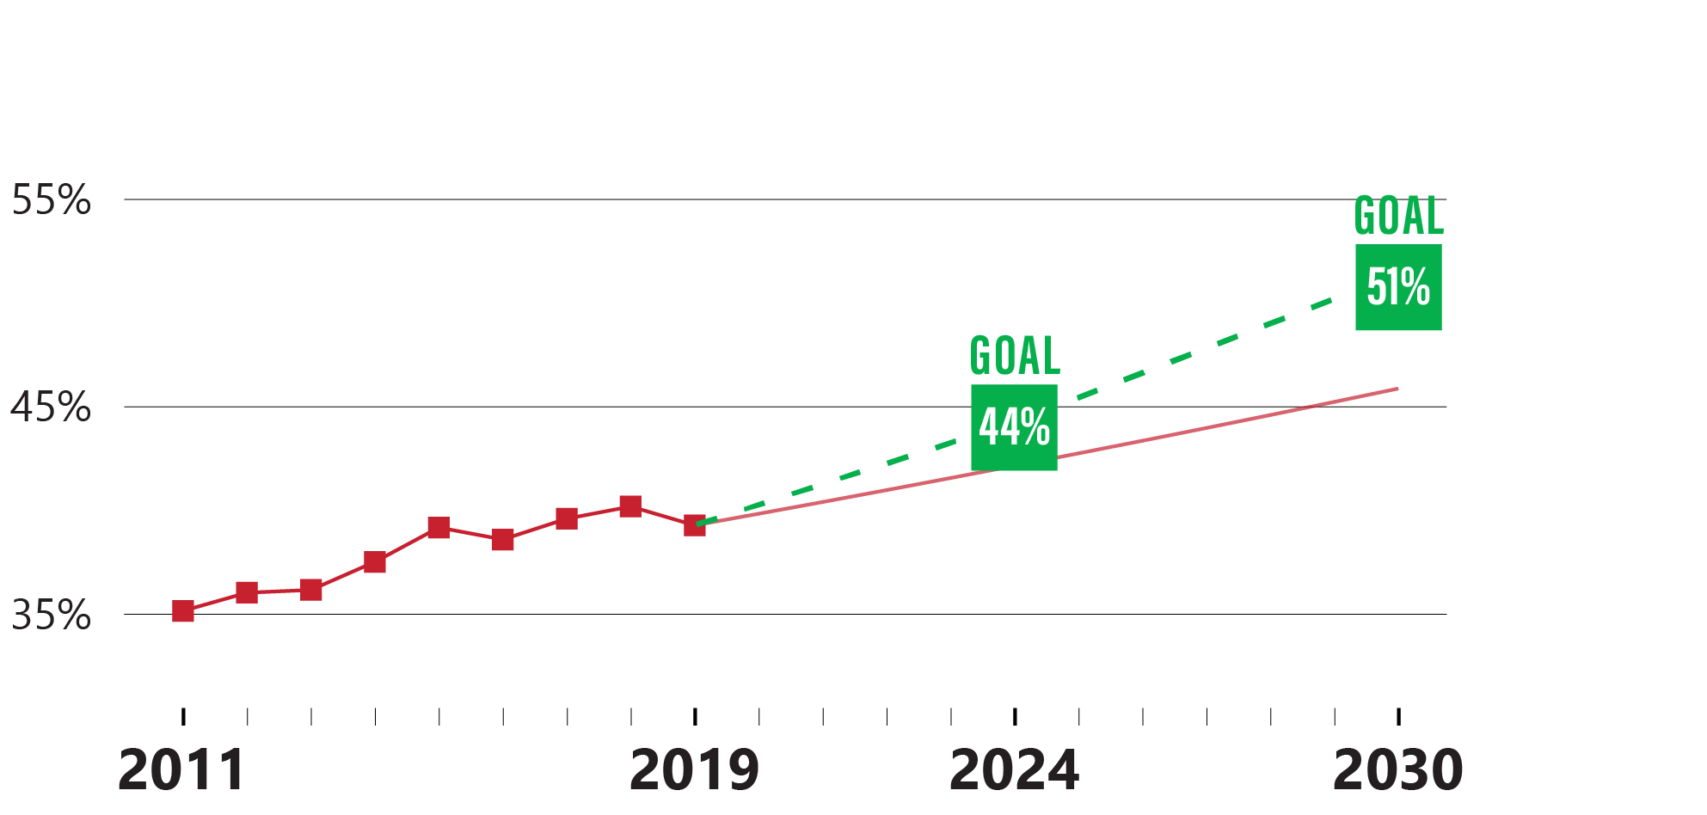
3. Equity in Public Higher Ed Completion
Massachusetts Public Higher Education Goals
% of students completing credential after first enrolling in Mass. public higher education—African American
(Entered 2005, earned credential by 2011)
(Entered 2013, earned credential by 2019)
(Entered 2018, earn credential by 2024)
(Enter 2024, earn
credential by 2030)
Goal represents aspiration to exceed current pace by 5% in 2024 (42 * 1.05 = 44)
and 10% in 2030 (46 * 1.1 = 51)

Slide 39
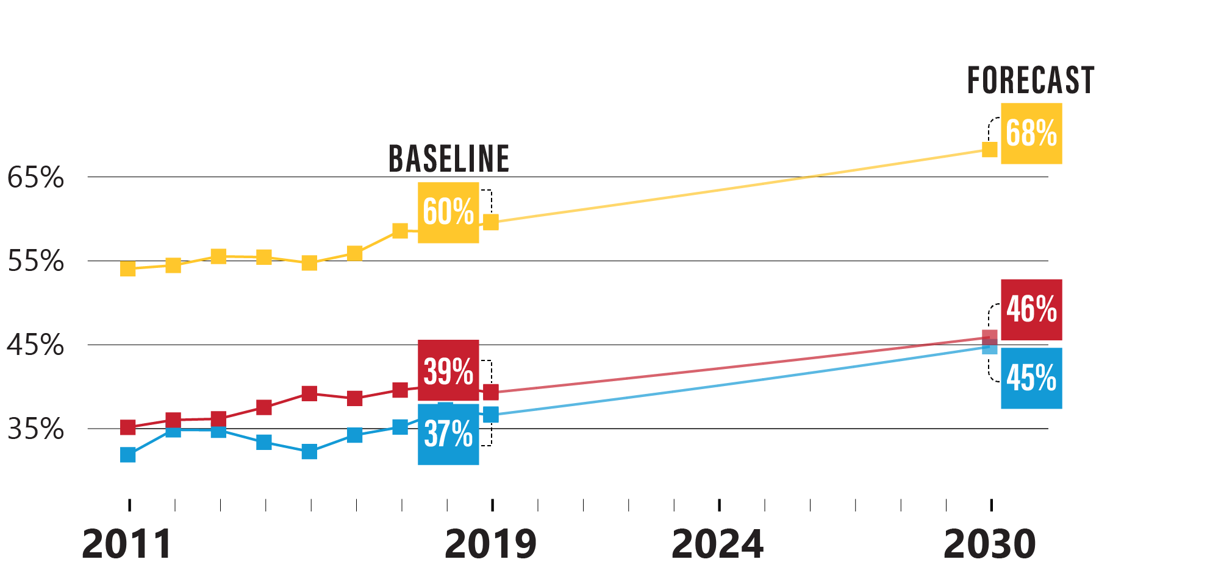
3. Equity in Public Higher Ed Completion
Massachusetts Public Higher Education Goals
Context: Forecast shows disparities widening slightly over time, despite increased rates for each subgroup

Slide 40
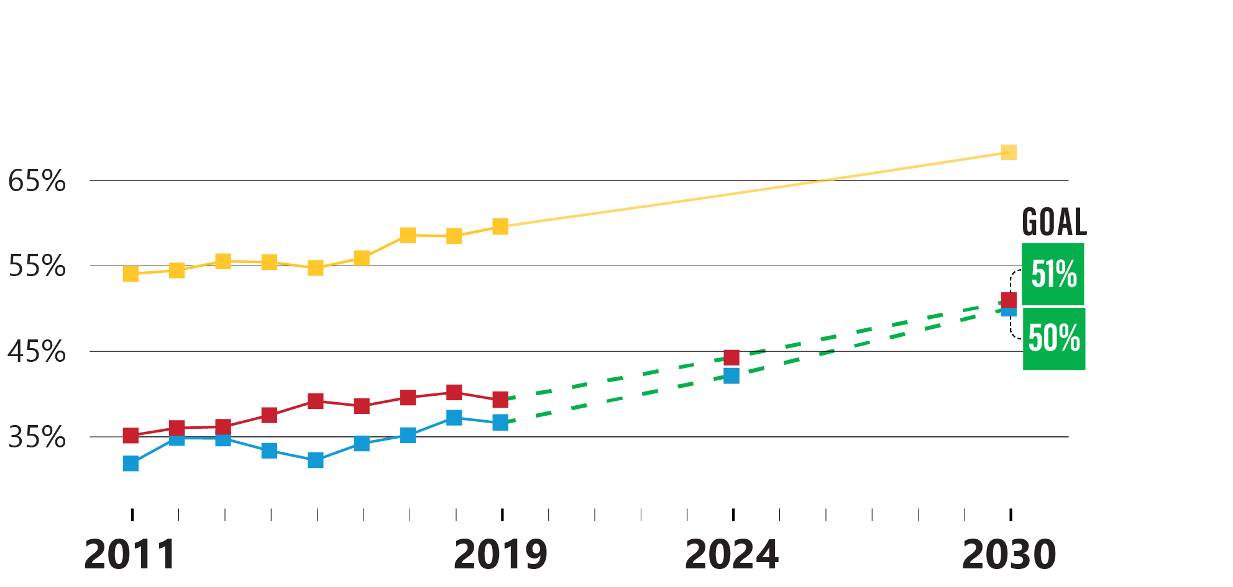
3. Equity in Public Higher Ed Completion
Massachusetts Public Higher Education Goals
Context: Achieving 2030 goal would mean a nearly
25% reduction in disparities, along with increased rates for each subgroup

Slide 41
4. Equity in First-Year Success
Massachusetts Public Higher Education Goals
Short-Term Reporting
While pursuing these long-term goals, DHE will also track
and report on racial/ethnic gaps in first-year success metrics incorporated into PMRS, including:
Completion of college-level math
and English in the first year
On-time credit accumulation
Persistence to a second year of
postsecondary education
Source: Massachusetts Department of Higher Education (HEIRS)

Slide 42
Planning to Develop
Equity Agenda Goal Dashboard
Equity-Minded Goalsetting

Slide 43
Data Dashboard Challenge Grant
Planning to Develop Equity Agenda Goal Dashboard
DHE was solicited to apply for a
Data Dashboard Challenge Grant, created to help states develop dashboards that:
  Improve utilization
  of state data systems
  for policy-making
  and decision-making
  May serve as exemplars
  to other states

Slide 44



Dashboard Vision
Planning to Develop Equity Agenda Goal Dashboard
Support the needs of stakeholders
to ensure student success by:
monitoring and reassessing progress toward DHE’s Equity Agenda goals at the state level, as well as regional or local level, through 2030 | understanding how the goals interrelate | testing and demonstrating the potential effect of different policy & budgetary levers on outcomes

Slide 45


Phase One: Planning & Buy-in
Planning to Develop Equity Agenda Goal Dashboard
To mobilize higher education and advance state policy to support the Equity Agenda, dashboard must be:
built through system-wide collaboration | highly relevant to decision-makers who ultimately influence alignment of resources with goals

Slide 46
Phase One: Planning & Buy-in
Planning to Develop Equity Agenda Goal Dashboard
In planning and throughout project,
DHE will consult with:
  Partners in state government (BHE, EOE, BESE/DESE, EOLWD)
  Leadership of public campuses
  Institutional research colleagues from public campuses
  Representatives of other intended audiences (campus trustees, Governor’s Office, Legislature, think tanks, business leadership groups, philanthropic organizations, etc.)
  Researchers & academics from outside the public higher
  education system

Slide 47


Phase Two: Analysis
Planning to Develop Equity Agenda Goal Dashboard
The project will require extensive methodological work, including:
a method to knit the Equity Agenda goals together so that projected progress on Goal 3 can be seen in Goals 1 & 2 | projections of baseline public higher ed enrollment for next 5–10 cohorts | methodologies to demonstrate and model the impact of policy & budgetary decisions on Goal 3, and consequently Goals 1 & 2

Slide 48
Phase Two: Analysis
Planning to Develop Equity Agenda Goal Dashboard
Policy and budgetary levers that
we’ll explore with research & data
science experts include changes in:
  First-year momentum (Goal 4)
    Rate of completion of Gateway Math & English courses
    during first year (or first 24 credits)
    On-time credit accumulation rates during first year
    (or first 24 credits)
    Rate of retention from first year to second year
  Enrollment or representation rates
  Participation in Early College and other innovative pathways
  Affordability (net price, unmet need, etc.)
  Participation in wraparound student supports

Slide 49


Phase Two: Analysis
Planning to Develop Equity Agenda Goal Dashboard
Depending on the lever, analysis may call
for an academic research approach or
a data science approach; for example:
To model impact of participation in Early College, we can examine existing academic research, seeking studies of comparable programs/states and drawing insights from their findings | To model impact of meeting On-time Credit Accumulation targets vs. not, we can likely draw insights from our own campuses’ historical data

Slide 50




Phase Three: Design
Planning to Develop Equity Agenda Goal Dashboard
DHE will then design a public-facing dashboard that fulfills the vision with:
technical support to incorporate complex features such as dynamic forecasting with interrelated parameters | continued engagement of stakeholders to vet prototypes and ensure continued buy-in

Slide 51


Phase Four: Operationalization
Planning to Develop Equity Agenda Goal Dashboard
To ensure sustainability and ability to share with other states, the
project will conclude with:
documentation of methodological, architectural & technical decisions | operationalized dashboard published on DHE website

Slide 52
Discussion

